Slide 1

AD_Hoc Insights Consumer Goods
CREATED BY
SUJATA SAINI

Slide 2

WHY ? oBJECTIVE
Why?
objective
WHAT ?
Company’s details and market
How?
Data, requests, and tools

Slide 3
Objectives
Company Details
Atliq hardware(fictitious corporation)is one of the major computer hardware manufacturers in India, with a strong presence in other nations.
Nevertheless, the management did note that they do not have sufficient insights to make prompt, wise, and data–informed judgments.
Plain to expand the data analytics team by adding junior data analysts.
To access candidates, Data analytics director, Tony Sharma plans to conduct a SQL challenge to evaluate both tech and soft skills.
The company seeks insights for 10 ad hoc requests.

Slide 4
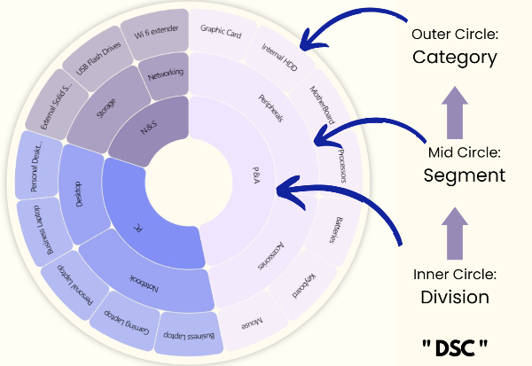
Company Details
Company Details
Atliq Hardware is a computer hardware and accessory manufacturer.
Fiscal YEAR
SEPTEMBER 2019-AUGUST 2020
FY 2020
SEPTEMBER 2020-AUGUST 2021
FY 2021

Slide 5
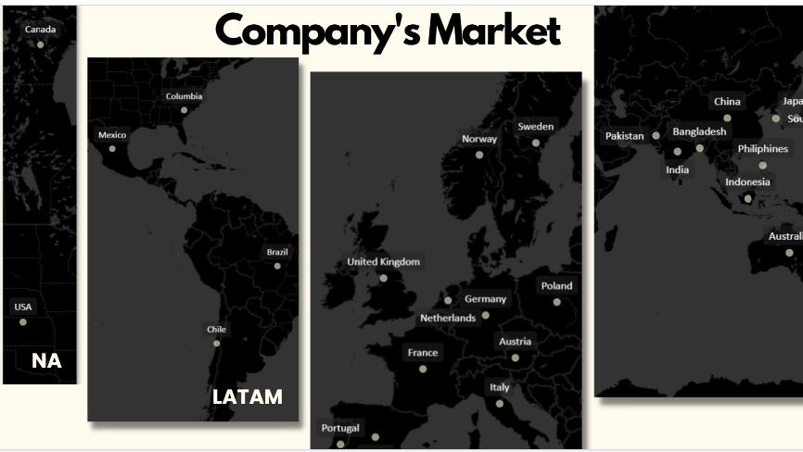

Slide 6
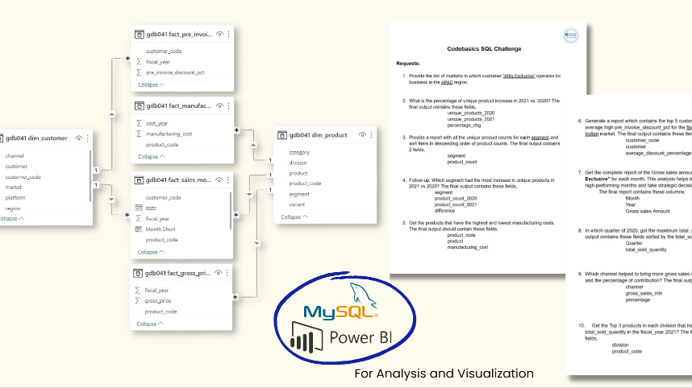
DATA ,Requests and Tool

Slide 7
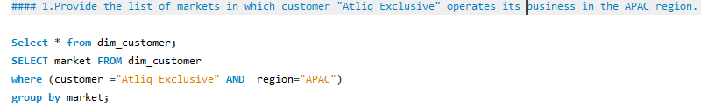
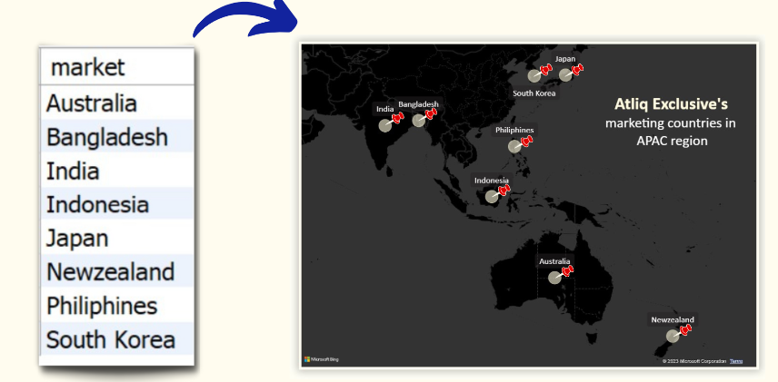

Slide 8
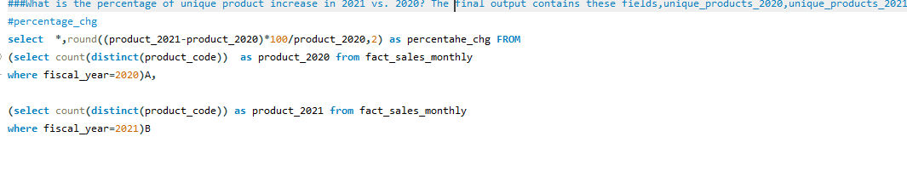
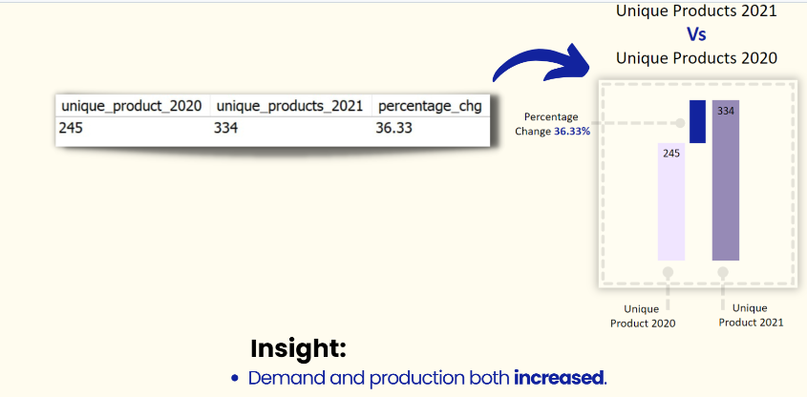

Slide 9
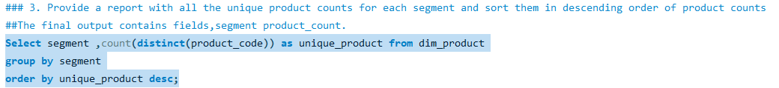
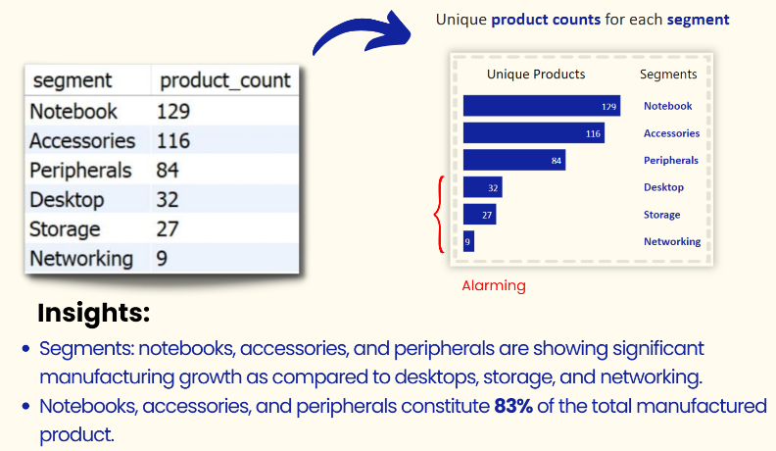

Slide 10
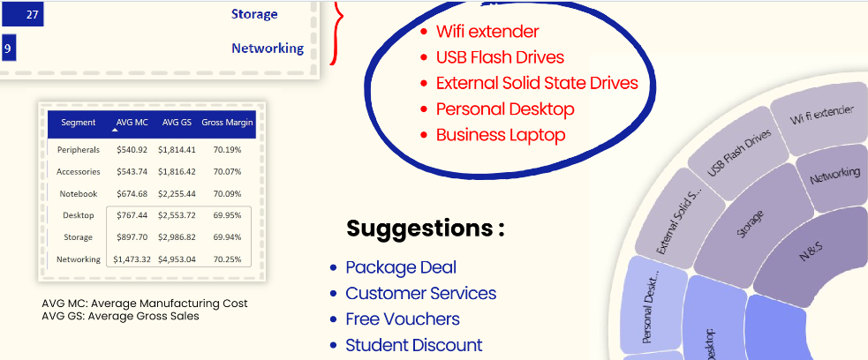

Slide 11
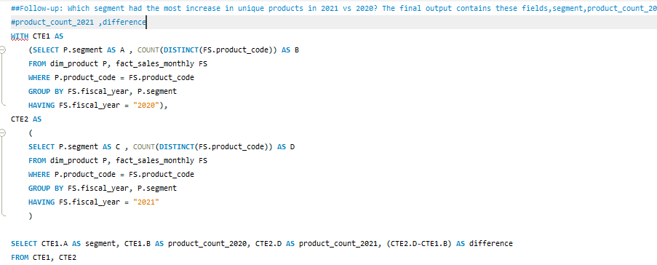
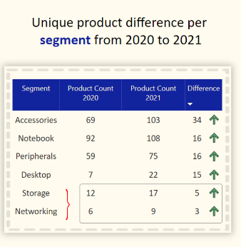
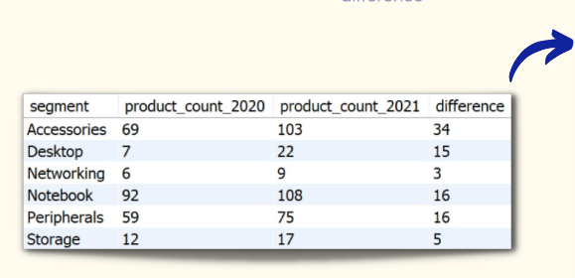
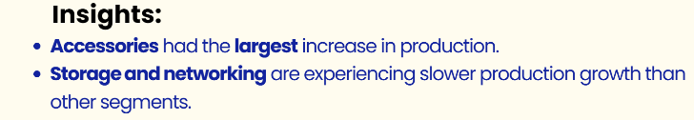

Slide 12
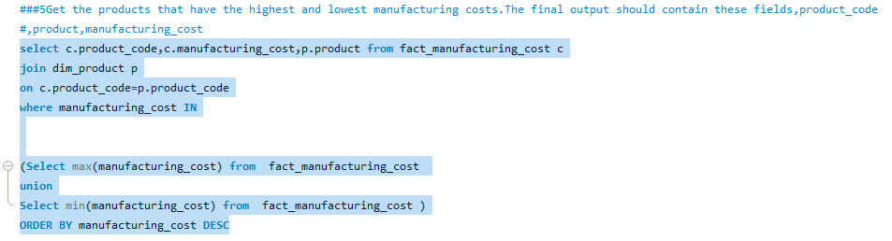
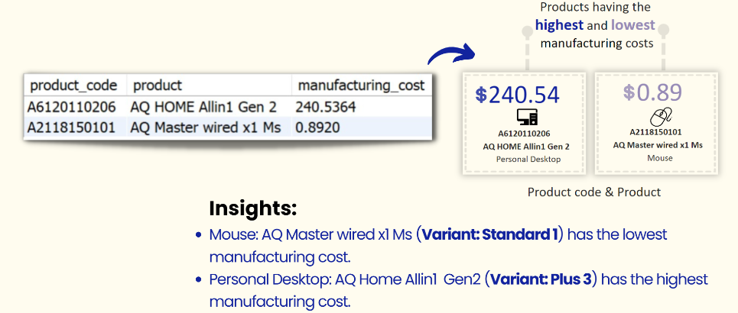

Slide 13
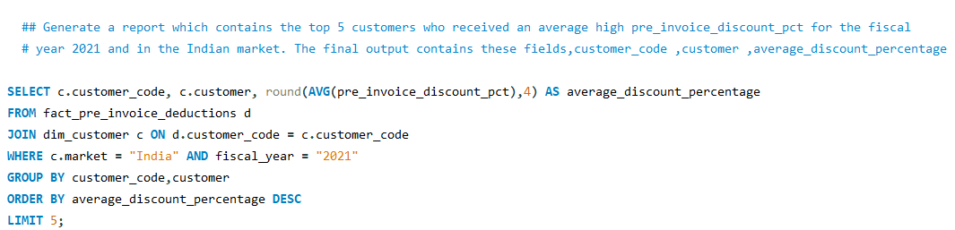
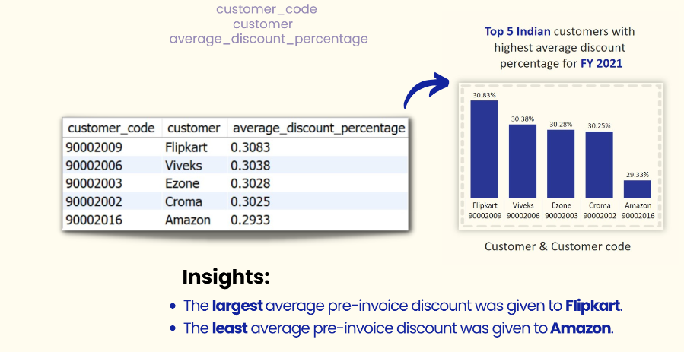

Slide 14
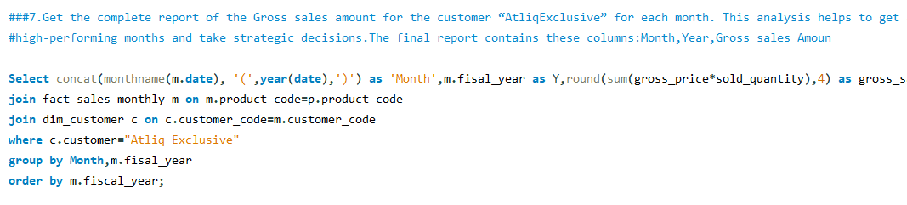
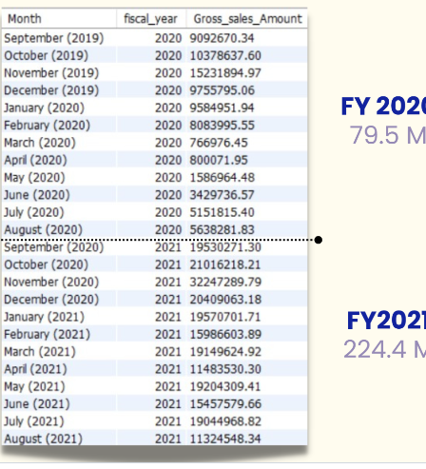
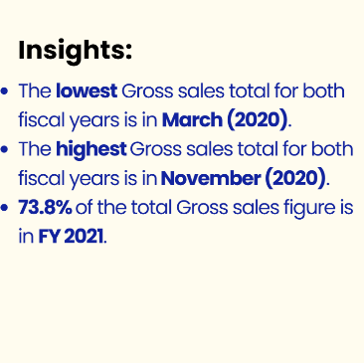

Slide 15
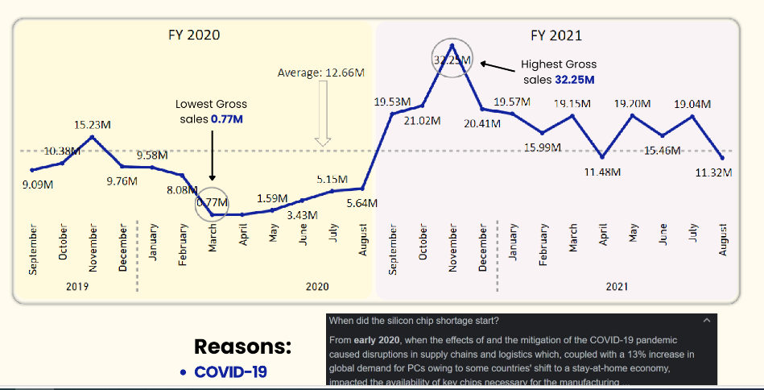

Slide 16
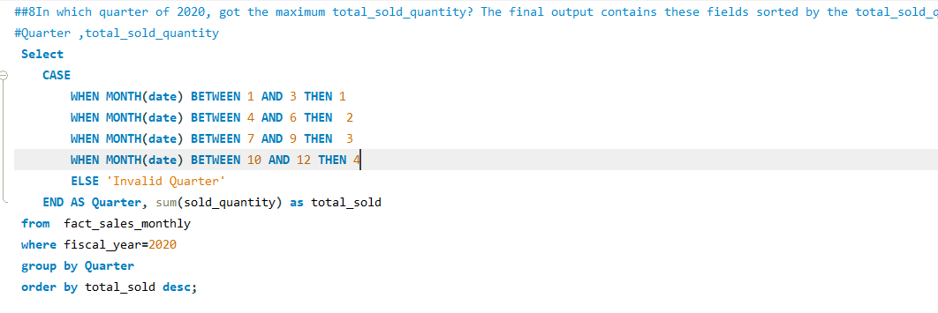
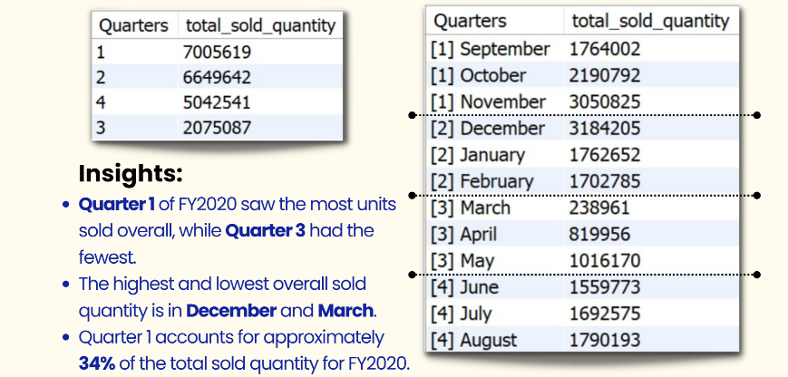

Slide 17
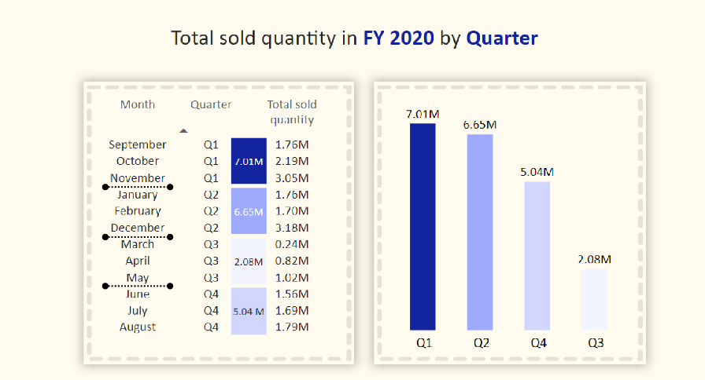

Slide 18
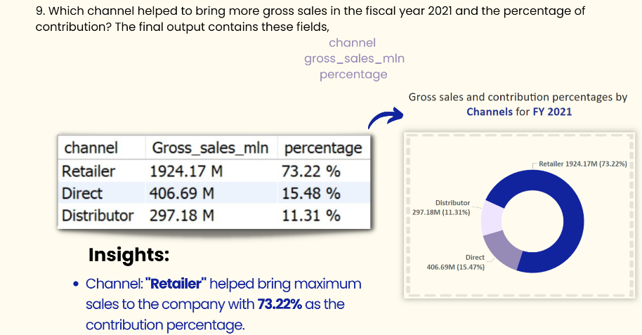

Slide 19
